Slide 1
Introduction to Julia
A programming language for scientific computing

Slide 2
Content
What is Julia?
Why Julia?
Python vs Julia
What makes Julia fast?

Slide 3
What is Julia?
In a Nutshell:
Julia is a fast programming language, designed from the ground up for high performance.
Julia is dynamically typed, it feels like a scripting language and has great support for interactive use.
Julia is reproducible, having a built-in package manager and being available across a wide range of platforms.
Julia is Open Source – under the MIT license.

Slide 4
Why Julia? – The Two Language Problem
Develop code in an easy to use, dynamic language like Python or MATLAB
If code is performance sensitive, then rewrite your code in a faster language like C/C++ or Fortran.
Attempts have been made to make this easier, such as porting code like Linear Algebra to C and then calling from the slower language. (numpy for python)
Limited to what has already been ported over, what if that code doesn’t exist?

Slide 5
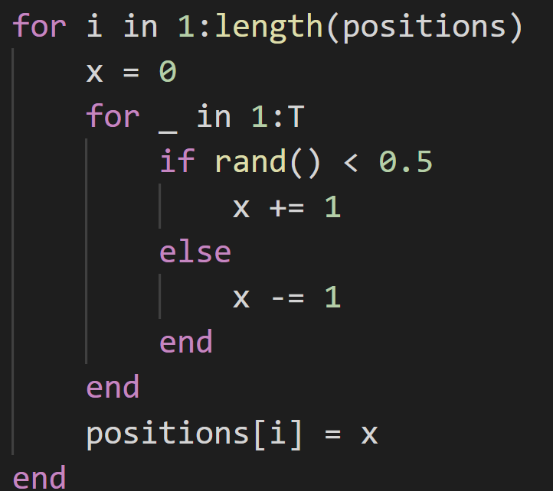
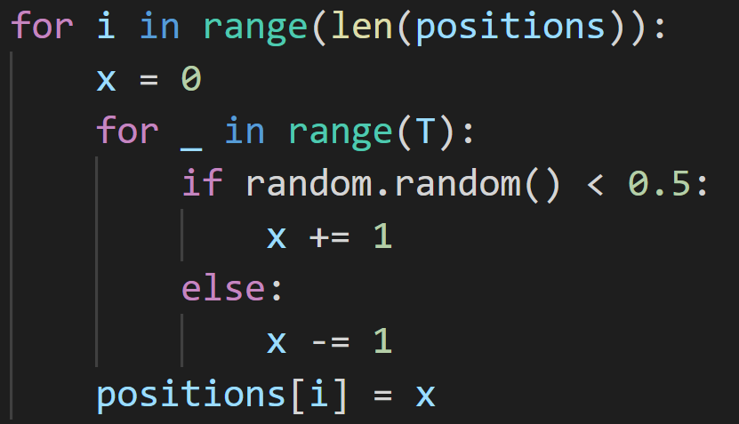


Python vs Julia – Random Walk benchmark
$$N=2^{10}$$
$$T=100$$
Julia:
Python:
$$N=2^{10}$$
$$T=100$$
8509.3 μs
313.5 μs
Julia is around 30 times faster here

Slide 6
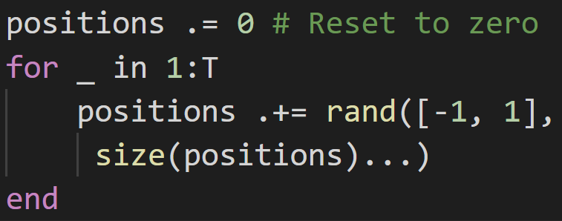
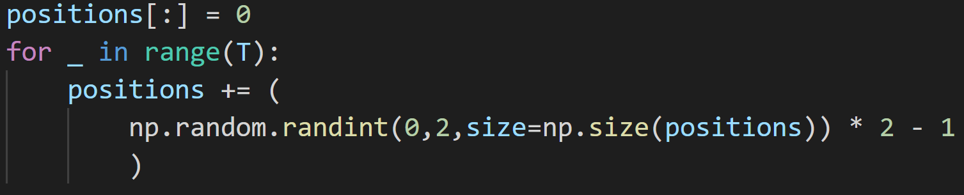
Python vs Julia – Random Walk w/ Arrays
$$N=2^{10}$$
$$T=100$$
378.7 μs
Julia:
1415.8 μs
Python:
Julia is only around 4x faster here, but numpy implementation could be better

Slide 7
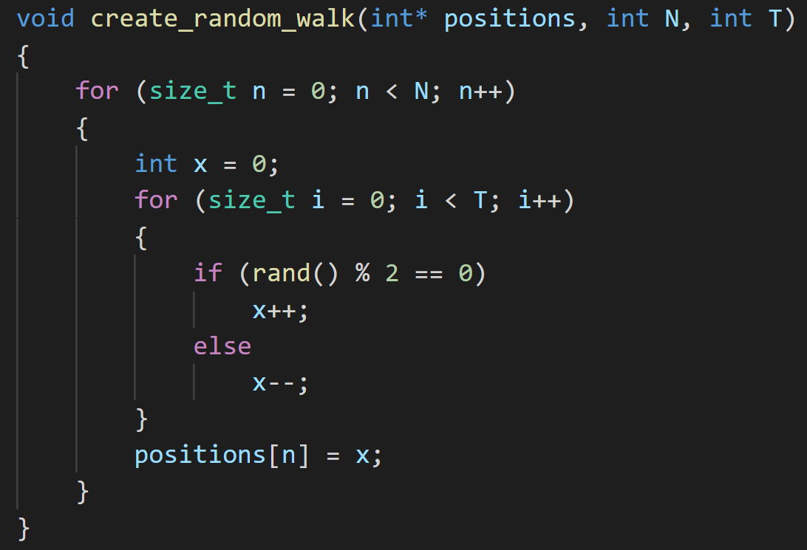
C++ vs Julia – Random Walk benchmark
$$N=2^{10}$$
$$T=100$$
Julia:
C/C++:
$$N=2^{10}$$
$$T=100$$
509 μs
313.5 μs
Julia is around 1.6 times faster here

Slide 8
Why is Julia fast?
Just-in-Time compiled, which specialises on the types of the variables.
Compiler tries to perform many optimisations, such as Single Instruction Multiple Data (SIMD) commands which most modern CPUs support.
Only fast if type stable!

Slide 9
So what?

Slide 10
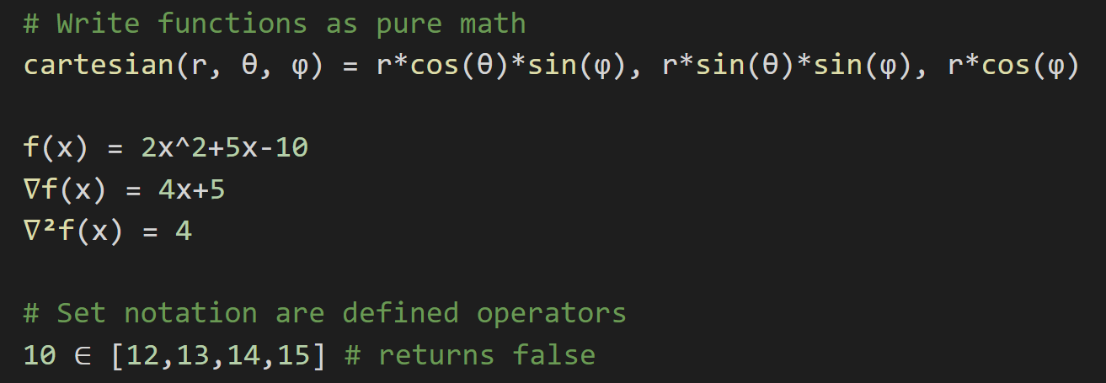
Interesting language features
Full support for Unicode:

Slide 11
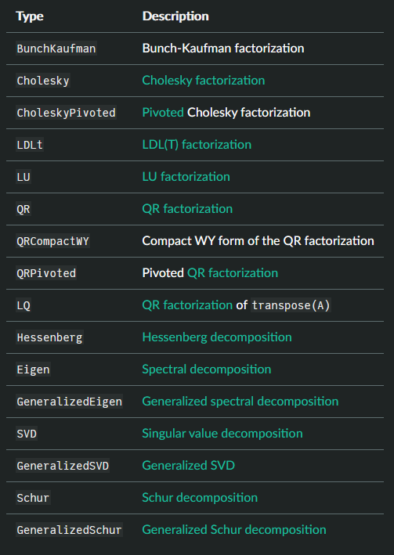
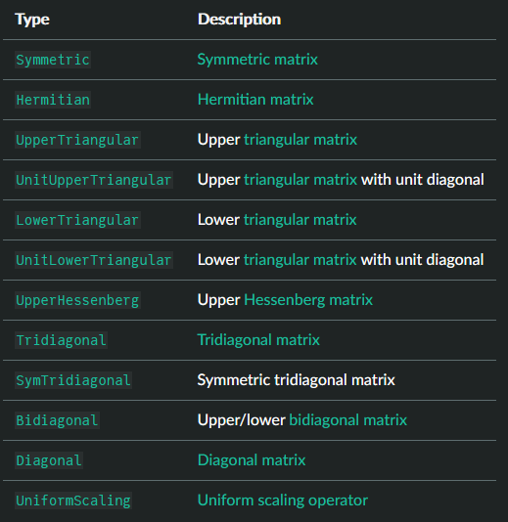
Interesting language features
Native support for linear algebra: (with choice of OpenBLAS or MKL)

Slide 12
Interesting language features
Metaprogramming macros – code that writes code
@simd macro on for loops tells the compiler to write out a for loop in a hardware vectorised format
Threads.@threads will parallelise your code across multiple threads trivially
@btime (from BenchmarkTools.jl) allows you to easily benchmark code, without any boilerplate
Many code introspection tools like @code_warntype, @code_llvm and @code_native to help write performant code.

Slide 13
Interesting language features – LIVE DEMO
Great support for parallelising your code across multiple cores or an entire cluster
Great support for using GPUs!

Slide 14
Questions?

Slide 15
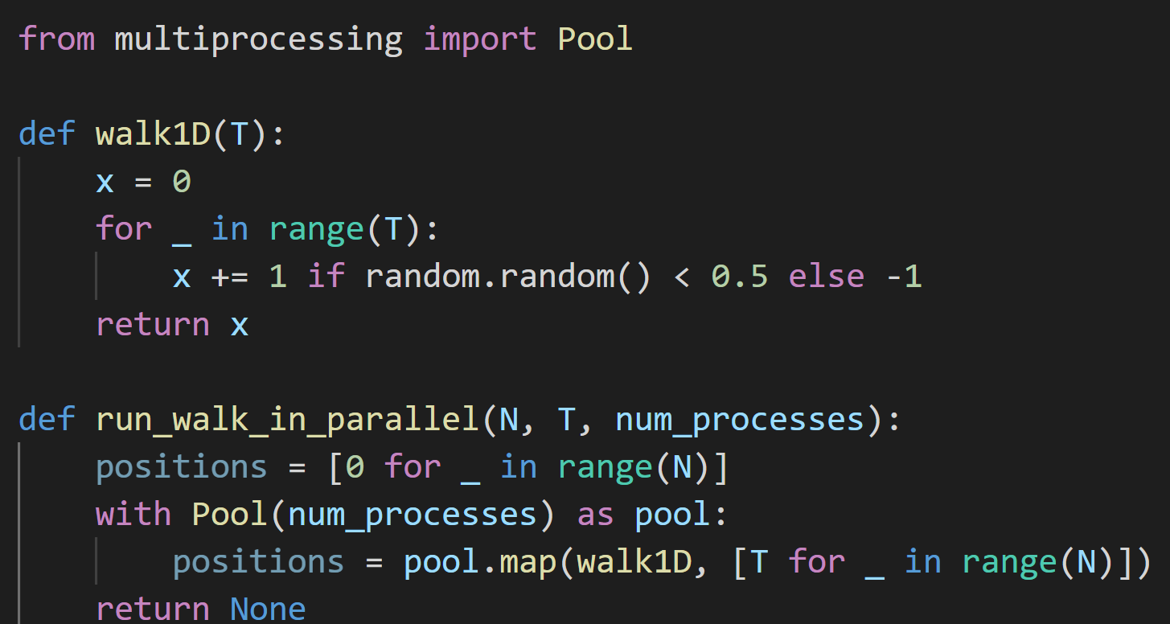

Python vs Julia – Random Walk in Parallel
Python:
$$N=2^{20}$$
$$T=100$$
1030ms

Slide 16
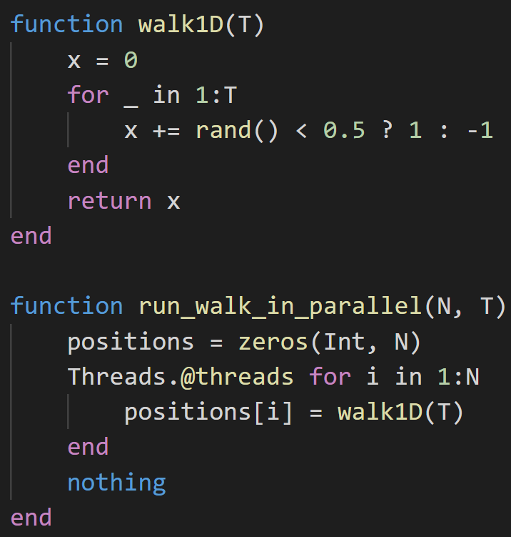

Python vs Julia – Random Walk in Parallel
Julia:
~40 times faster than in Python.
$$N=2^{20}$$
$$T=100$$
25.16ms

Slide 17
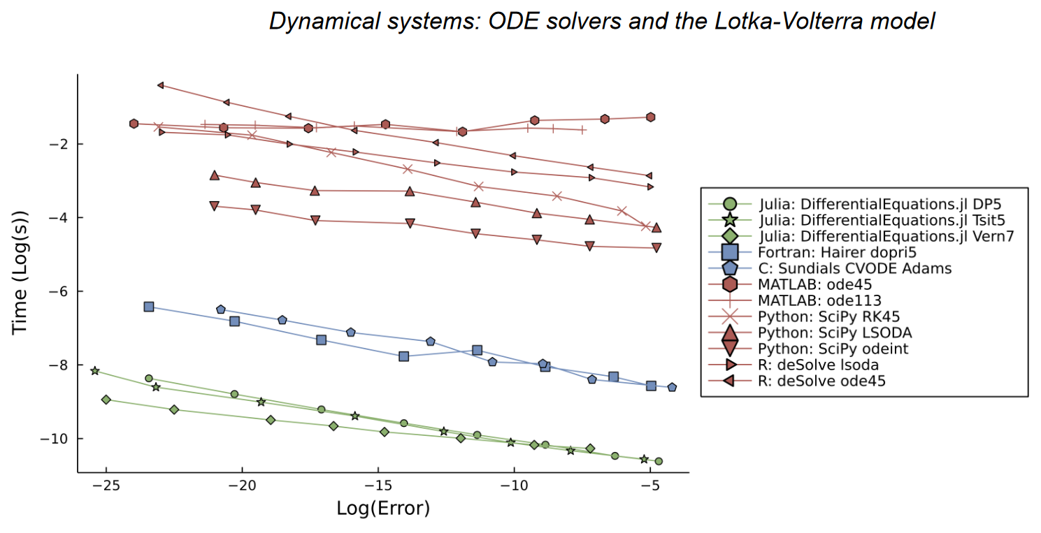
Performance in DifferentialEquations.jl
Julia for Biologists: https://arxiv.org/abs/2109.09973

